Slide 1
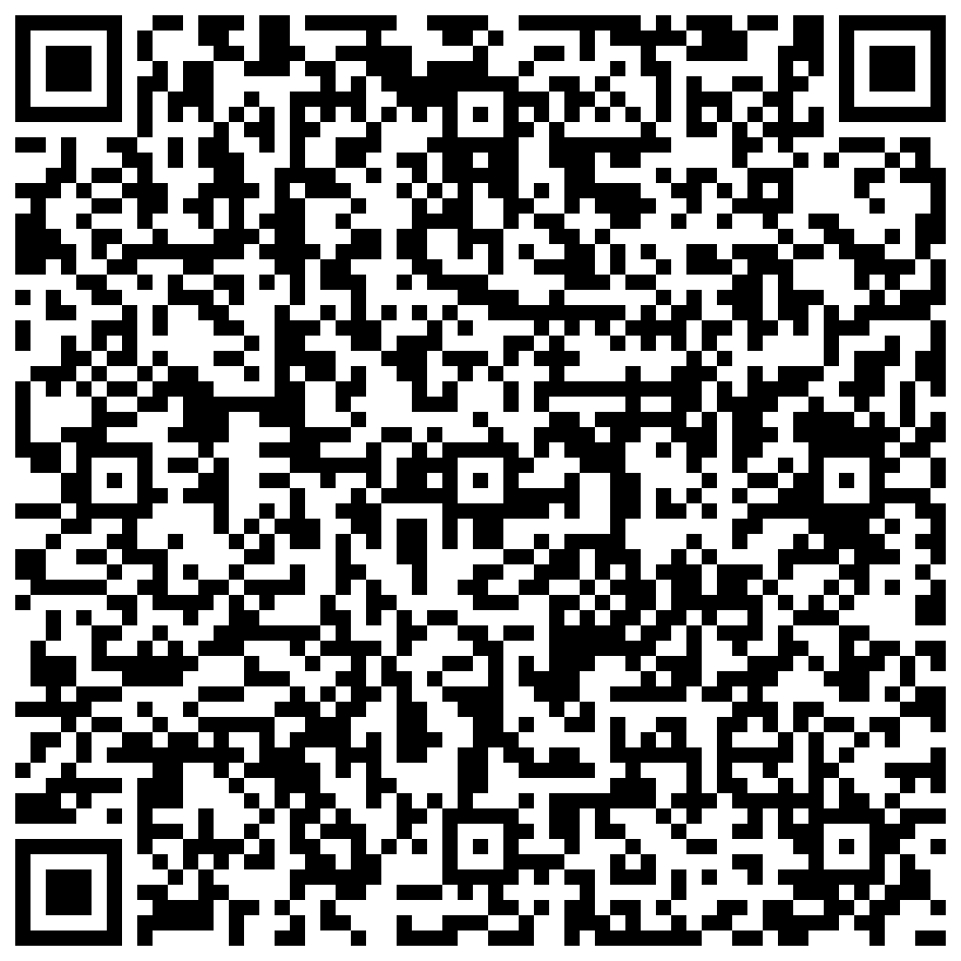
Product Integrity Assurance Platform
using Blockchain
Project Lead Member
Mrs. Brijesh Nishad
B Tech CSE-IOT

Slide 2
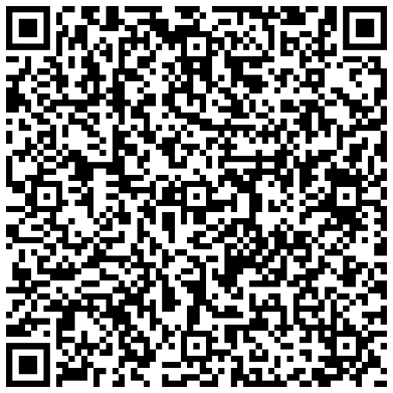
01
Overview
02
Key Features
Utilizes blockchain technology for secure product authentication.
Provides instant and reliable verification of product authentication
Implements smart contracts to automate verification processes
Utilizes blockchain's immutable ledger to store product information securely.
Implements unique product identifiers for each item on the blockchain.
Smart contracts enable automated verification and validation of product authenticity
03
Expected Impact
04
Implementation Strategy
Reduces the prevalence of counterfeit products in the market
Enhances consumer trust and confidence in product authenticity
Fosters a more transparent and trustworthy marketplace for businesses and consumers
Collaborates with manufacturers to integrate unique product identifiers into blockchain.
Develops a user-friendly interface for consumers and stakeholders to access authentication system.
Conducts extensive testing and validation to ensure system reliability and accuracy
Introduction

Slide 3

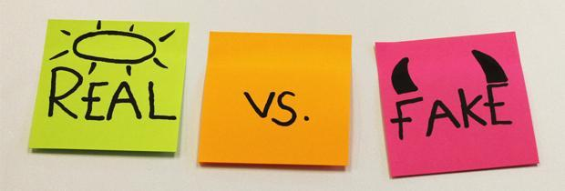

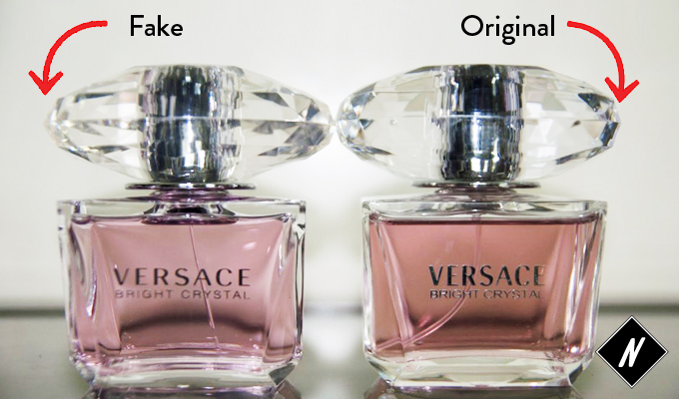
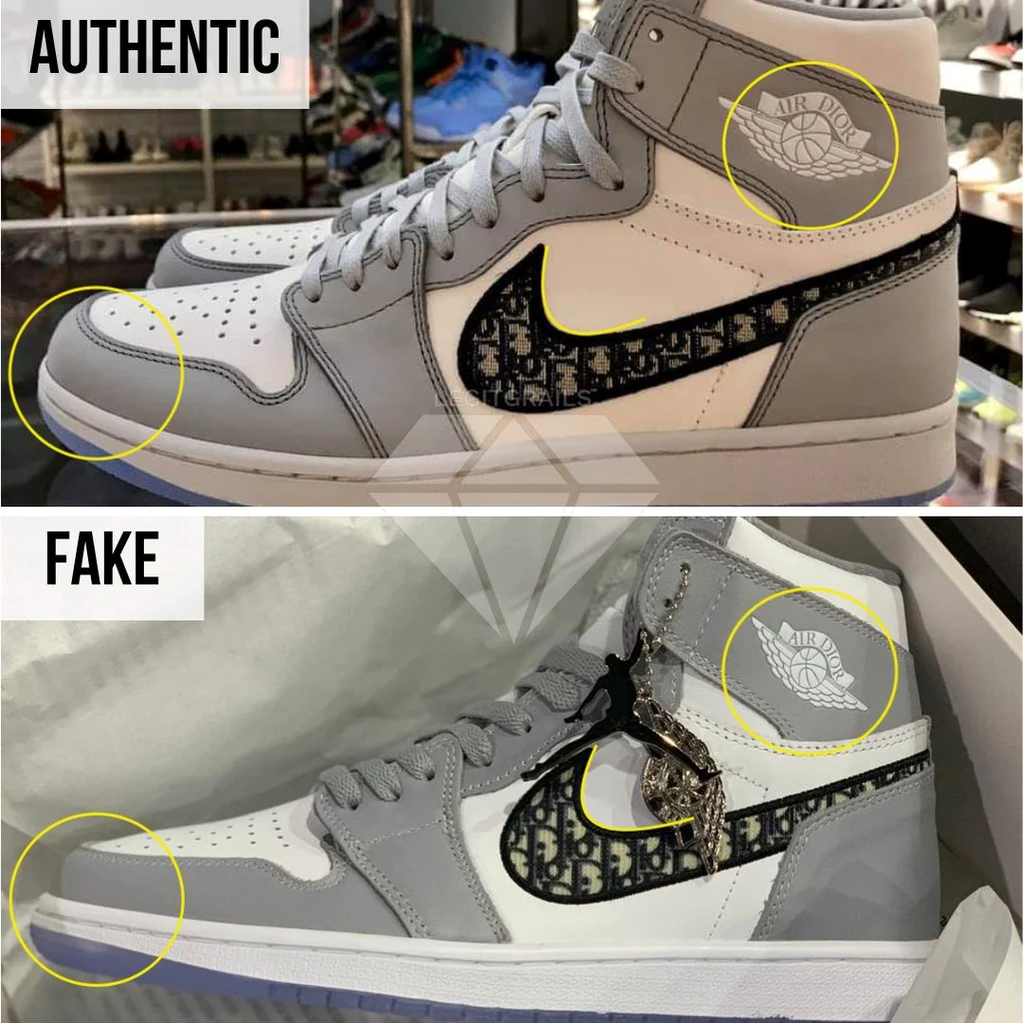
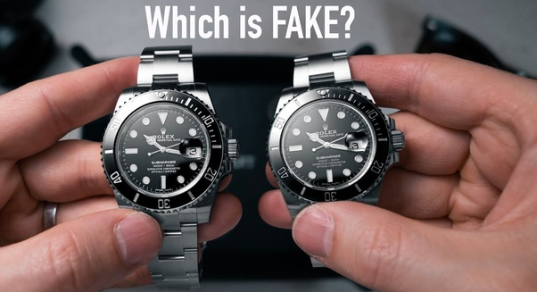
Problem Statement
Our objective is to tackle the growing issue of counterfeit products in digital commerce by introducing a 2D QR code system on items, utilizing blockchain technology to mint them as NFTs. This initiative aims to establish robust authentication processes, fostering transparency and confidence in product origins to combat counterfeit practices effectively.

Slide 4
Proposed Solution
Integration of 2D QR Codes
Tokenization as NFTs
Implement 2D QR codes for easy product verification.
QR codes serve as unique identifiers for each item.
Mint QR codes as Non-Fungible Tokens (NFTs) on the blockchain.
Each NFT represents a genuine product, ensuring authenticity.
Blockchain Transparency
Real-time Verification and Counterfeit Detection
Utilize blockchain's immutable ledger for transparent product history.
Track product journey from production to consumer, reducing counterfeit risks.
Enable real-time verification of product authenticity.
Implement algorithms for counterfeit detection, enhancing market trust.

Slide 5
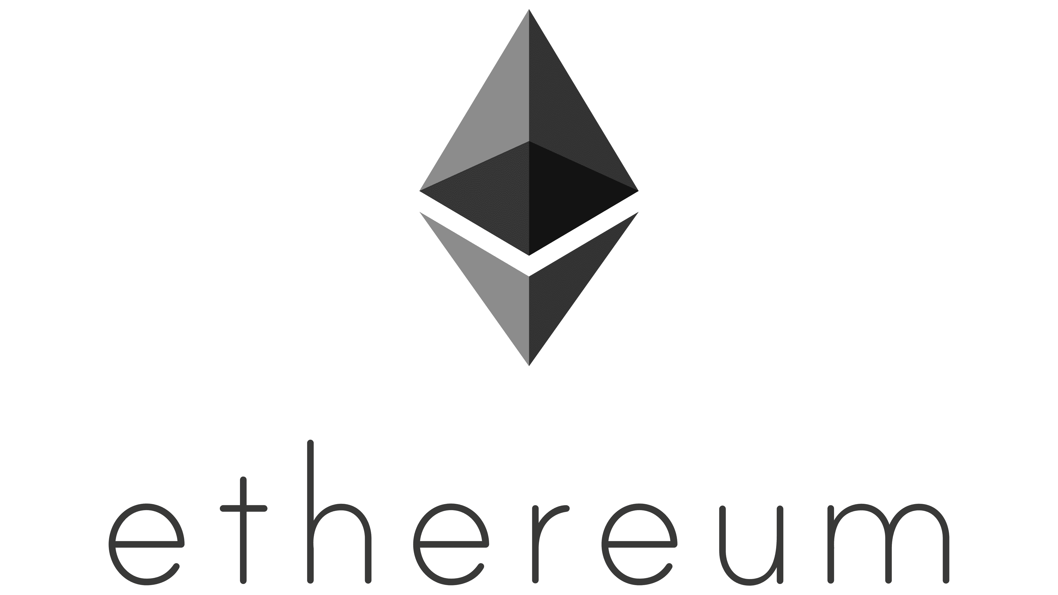
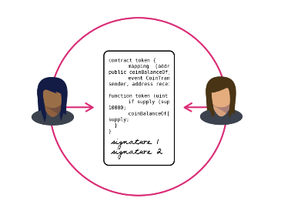
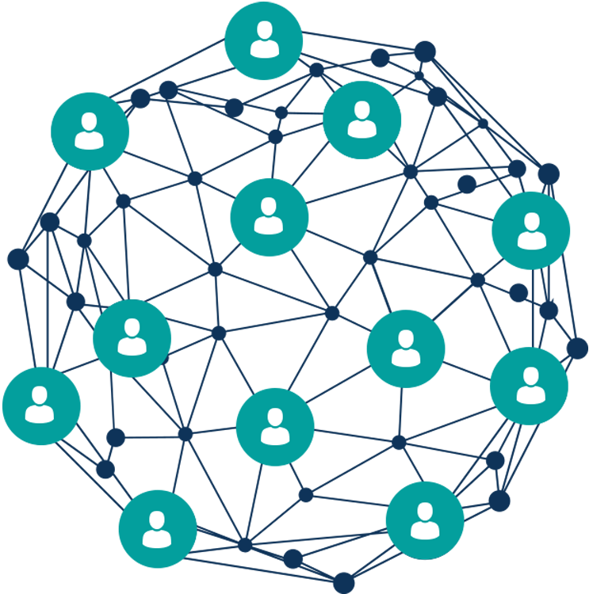

Technology used to develop this system
Smart contract, solidity
Ethereum
A smart contract is a self-executing contract with the terms of the agreement between buyer and seller being directly written into lines of code in solidity language. This code is deployed to the blockchain, where it can be executed automatically when certain predetermined conditions are met.
Ethereum is a decentralized, open-source blockchain platform that allows for the creation of smart contracts and decentralized applications (dapps).
Metamask(wallet)
Remix IDE
Metamask is a popular browser extension that allows users to interact with the Ethereum blockchain. It serves as a digital wallet for users to store, manage, and transfer their Ether and other Ethereum-based assets.
It is a tool that allows developers to write, test, and deploy smart contracts on the Ethereum blockchain and then deploy it to a testnet like Goerli for further testing and use.

Slide 6
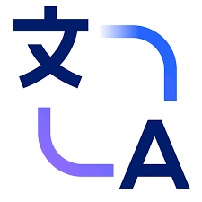
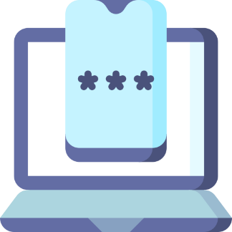
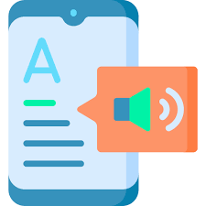

Technology used in Feature enhancement
Language Translator
Two Factor Authentication
Text to Speech
HTML,CSS and Javascript with google Trans api
React js ,and Mantra or morpho apps
HTML,CSS and javascript
Real time tracking
React js and Google map api

Slide 7
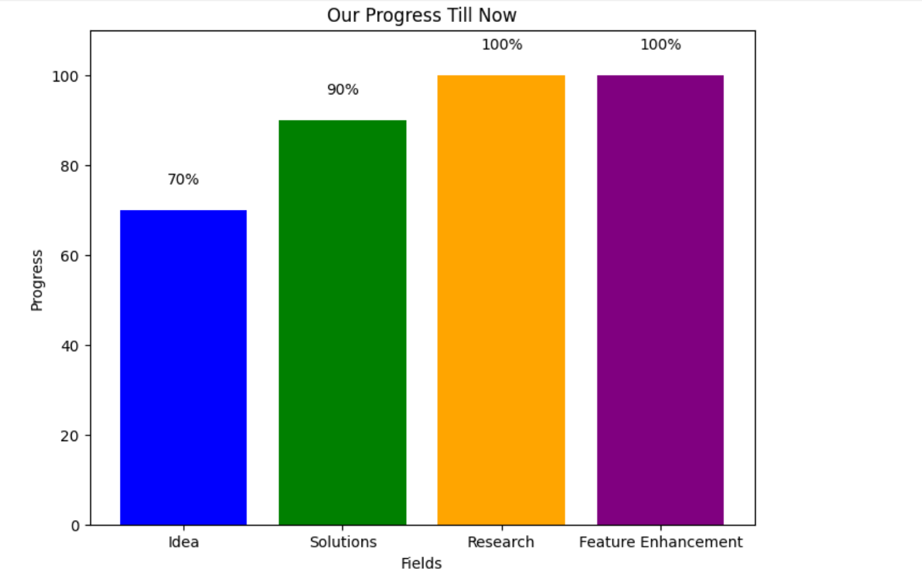

Slide 8
Steps for Authentication
Step 1: Scanning the QR Code
98%
Scanning in Progress
Step 2: Decoding the QR Code
Extracting unique identifier

Slide 9

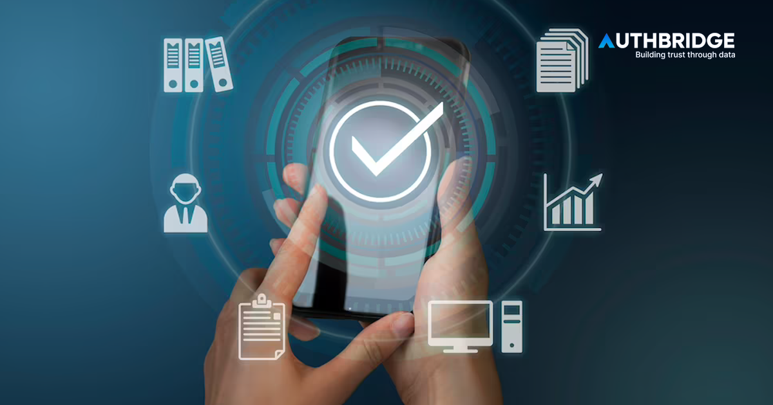
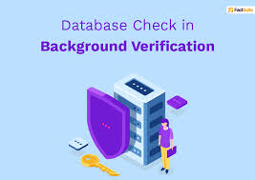

Step 3:Requesting Product Information
Step 6:Verification Process
The web page sends a request to the backend server, providing the unique identifier.
The customer reviews the product information to verify its authenticity.
They can also check the product's status on the blockchain, ensuring it has not been tampered with.
Step 4:Backend Verification
The backend server receives the request and queries the blockchain using the unique identifier to fetch the product's information.
Step 7: Feedback & Satisfaction
The customer reviews the product information to verify its authenticity.
They can also check the product's status on the blockchain, ensuring it has not been tampered with.
Step 5:Displaying Product Information
The information may include product details, manufacturer information, and authentication status.

Slide 10


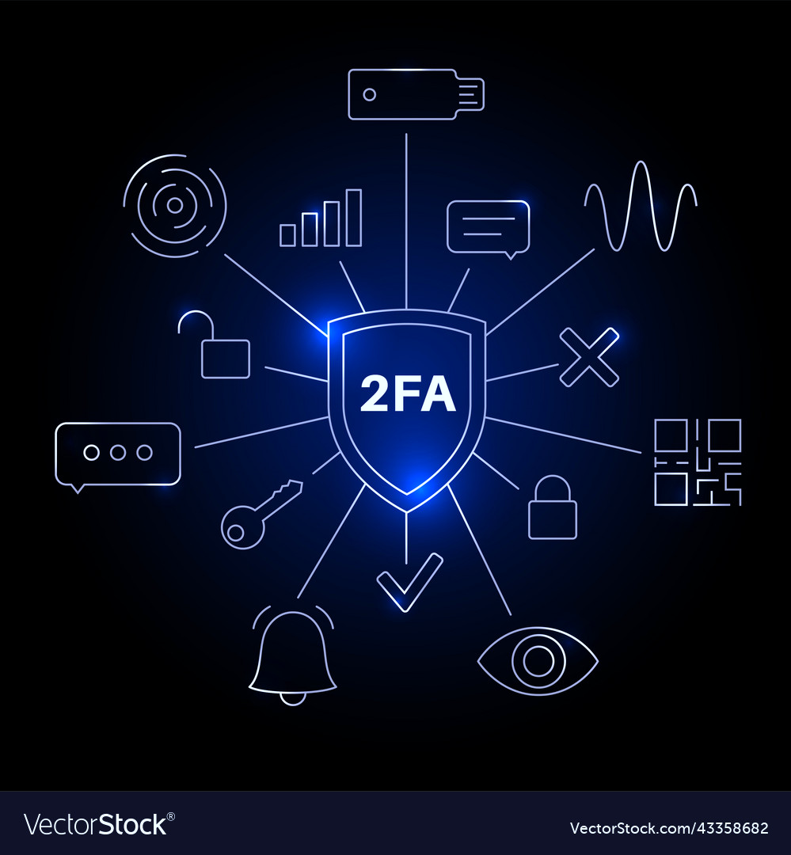
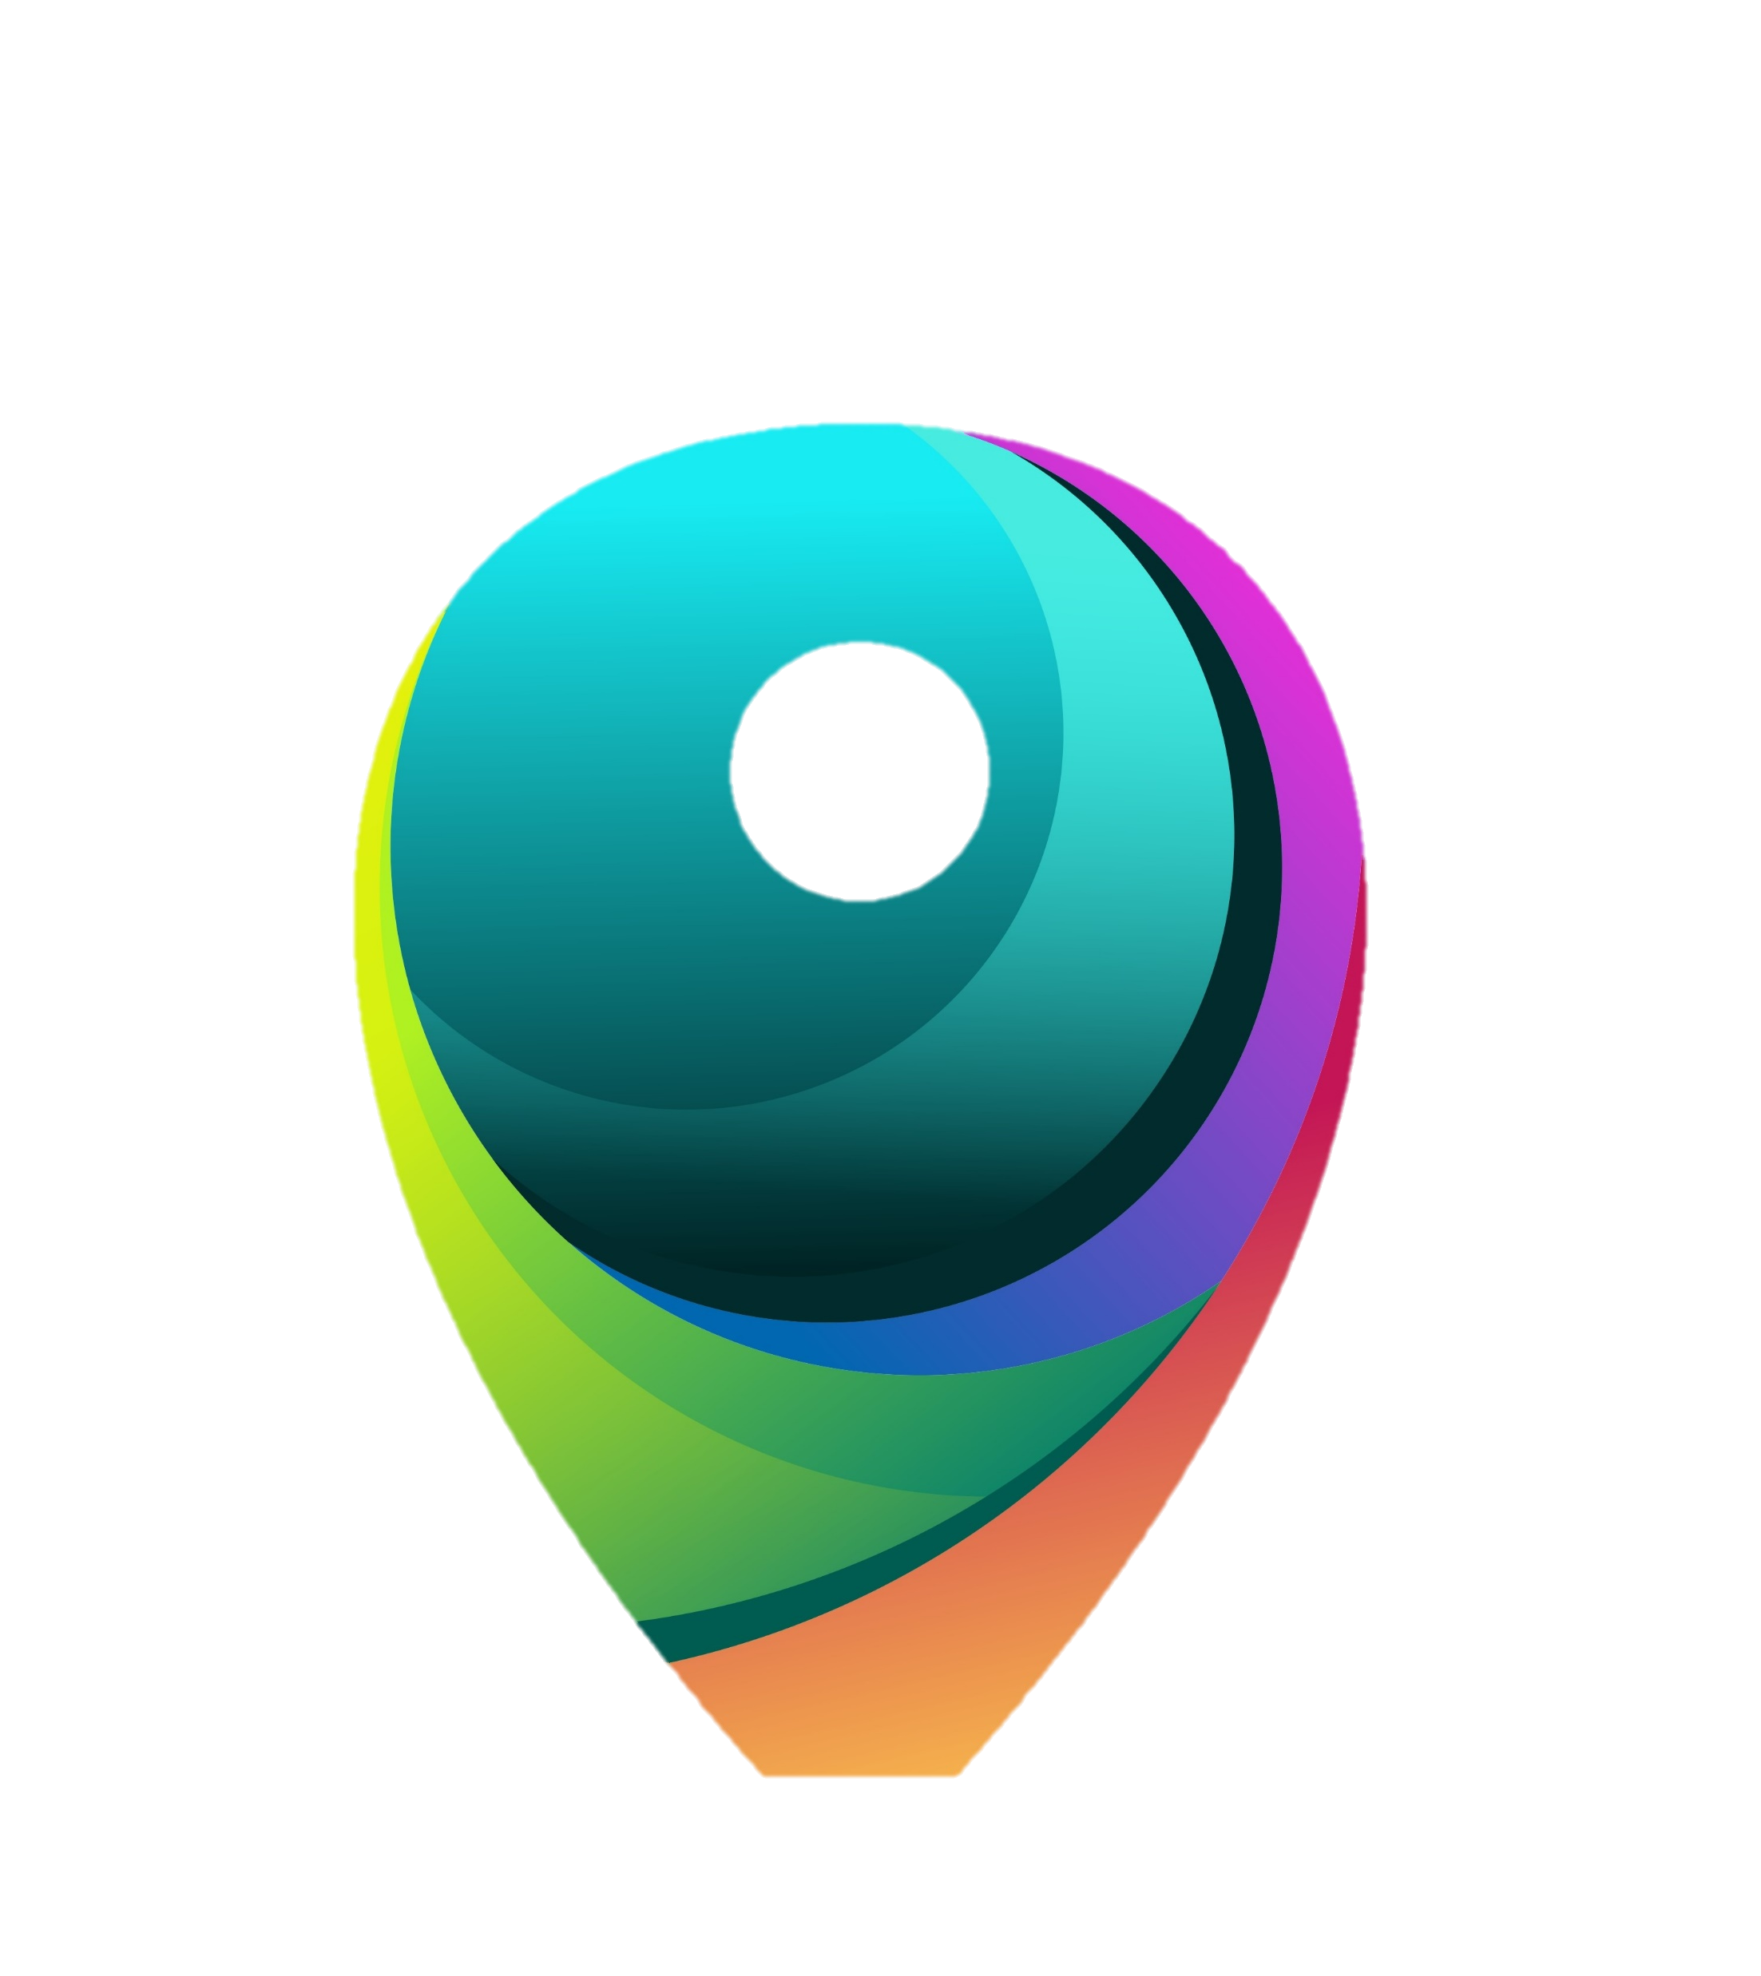
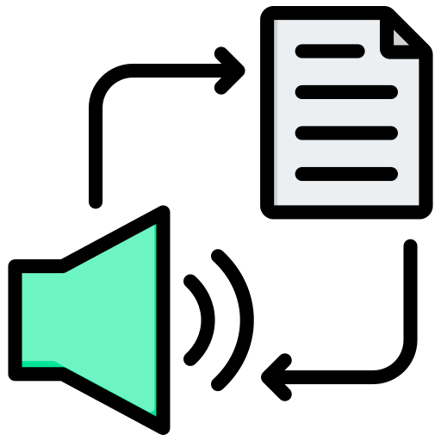
Additional Features
Language Translator
Two Factor Authentication
Using Google Cloud Translation API, Microsoft Translator Text API, or similar
Using libraries like `speakeasy` (Node.js)
Text To Speech
Real Time Tracking
Using Google Text To Speech API
Using GPS or RFID technology.

Slide 11
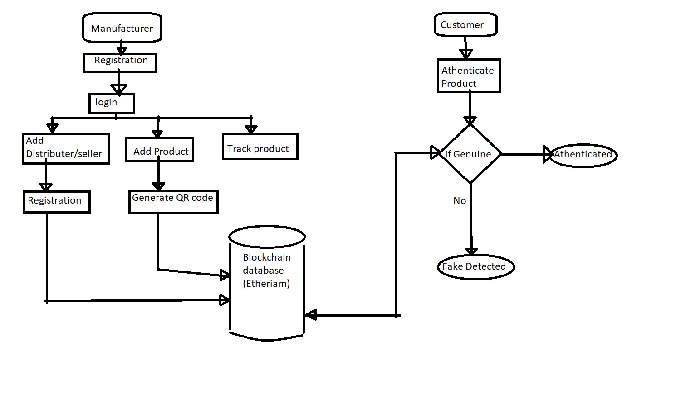
Schematic Representation of How Our Project
Work

Slide 12
Conclusion
We achieved aim to establish transparent authentication protocols, ensuring clear identification of genuine products and bolstering trust among consumers.

Slide 13
THANK YOU

